Slide 1

DigiBlock
Sai Shradha Lala (1906498)
Sakshi Gairola (1906499)
Chandra Prakash (1906548)
Pinaki Bhattacharjee (1906620)
📖 Under the Guidance of Mrs. Pratyusa Mukherjee

Slide 2
PROBLEM
The current document identity management system is "centralized" which gives birth to document frauds, and many major non-fault tolerant risks.

Slide 3

WHY DigiBlock ?
"Decentralized" and robust solution to the existing digital identity management system. Implements better standards, workflow and controlled access over personal documents.

Slide 4
OUR PILLARS
DApp
Blockchain
Web3
IPFS
Application which works on the principle of Decentralization
Immutable, Decentralized, Digital Ledger
Revolutionary iteration of WWW based on Blockchain Technology
Protocol and P2P network for Decentralized storage

Slide 5

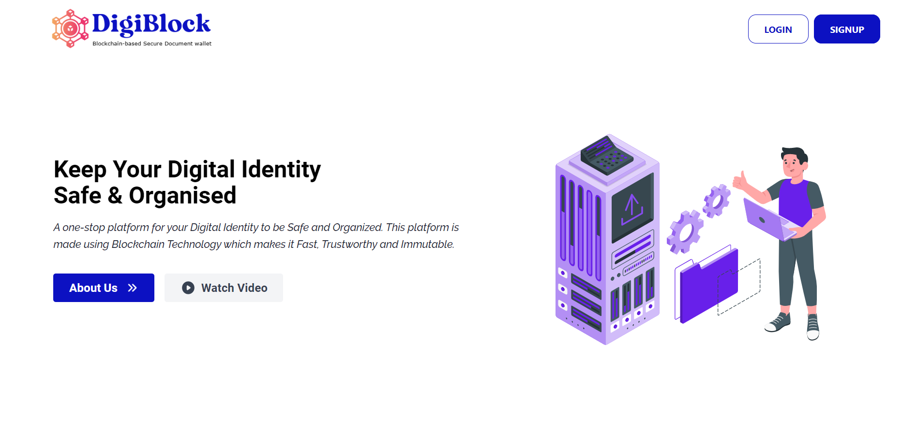
WORKFLOW
SRS Preparation
Frontend Architecture
Smart Contract Architecture
Backend Architecture
Integration
Testing
Deployment

Slide 6
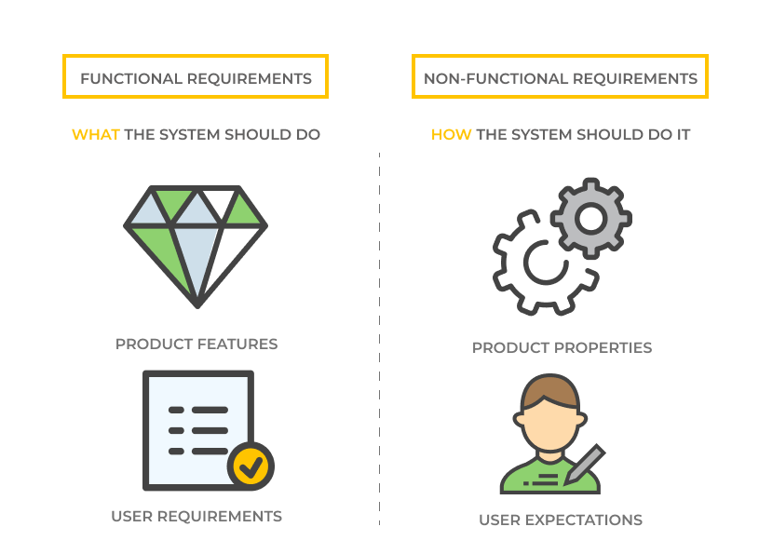
SRS PREPARATION
FUNCTIONAL & NON FUNCTIONAL REQUIREMENTS
SYSTEM ARCHITECTURE
UI & UX

Slide 7
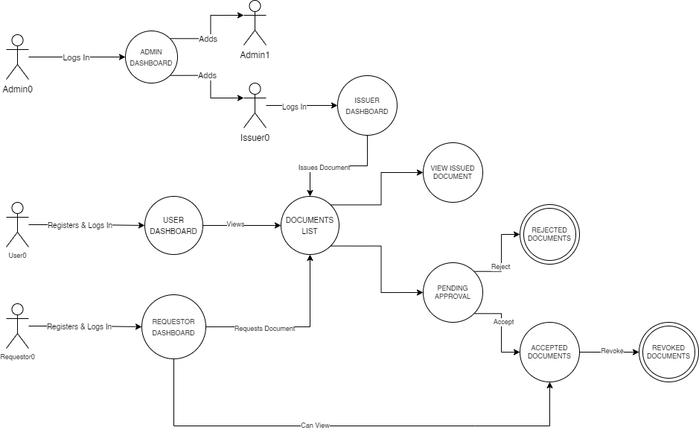
SYSTEM ARCHITECTURE

Slide 8
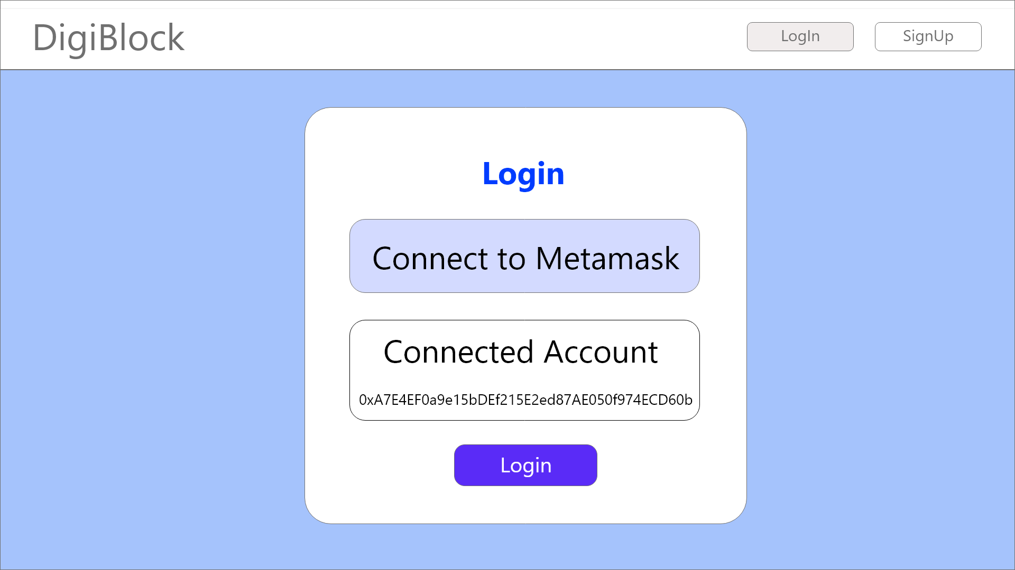
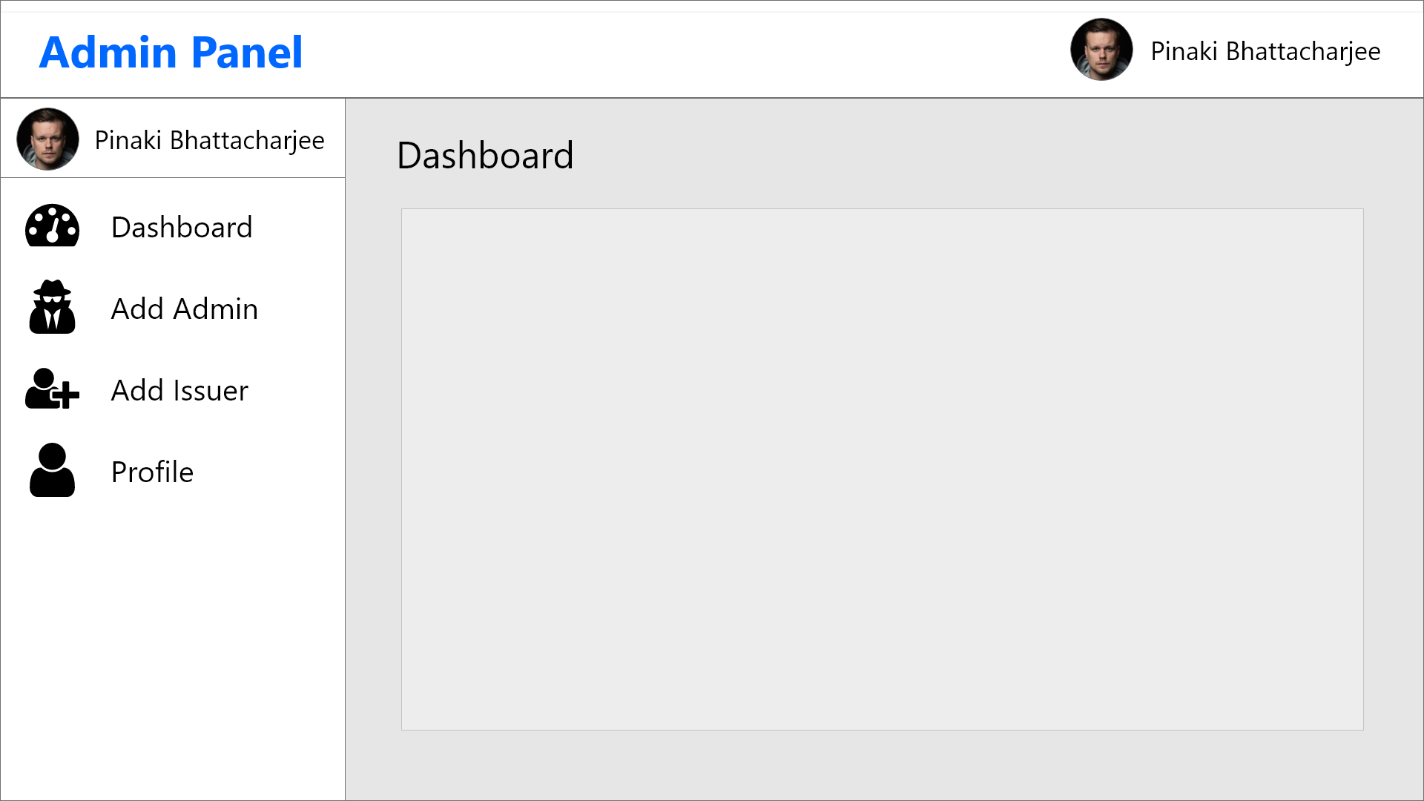
SRS PREPARATION
FUNCTIONAL & NON FUNCTIONAL REQUIREMENTS
SYSTEM ARCHITECTURE
UI & UX

Slide 9




FRONTEND ARCHITECTURE
React
Redux
Web3JS
Metamask
It is used to create the user interface of the DApp
It is used to manage the state of the DApp
Allowed us to interact with the ethereum nodes using HTTP
Stores and manages the wallet accounts to interact with DApp

Slide 10
SMART CONTRACT ARCHITECTURE
Basic Architecture
Admins
Users
Issuers
Requestors
Problems Faced
Based on Solidity version 0.8.10
Provides add, delete and view functionality to admins.
Functions to authenticate users and change document status.
Functions to issue and view documents issued to users.
Functions to authenticate requestors and send access request.
Smart Contract Size and Solidity

Slide 11
BACKEND ARCHITECTURE
REST API
DB
CRYPTOGRAPHY
REST API with custom loggers, rate limiters, added security to attacks and better error handling.
NoSQL MongoDB database with strict schemas to help the DApp to scale.
Encryption and Hashing.
Used bcrypt, HMAC object, aes-256-gcm etc.

Slide 12
INTEGRATION
Frontend + Web3
DApp + Backend
The frontend and Web3 were integrated using a library called “web3”, an Ethereum JavaScript API. It provided the frontend access to the blockchain and usage of Metamask.
The frontend was integrated to the backend using the "axios" library. The URL of the backend is injected into the application via an environment file. The payloads are delivered to the API via axios-created functions

Slide 13
TESTING
Smart Contract Testing
Backend Testing
We used Truffle to test our contracts which makes use of the Mocha testing framework and the Chai assertion language. We used ganache-cli as our local blockchain for running and testing, which provides some test accounts and ethers to DigiBlock to run our tests.
We used Postman and Insomnia for API testing, sending requests to a variety of endpoints and routes and comparing the expected results to different status codes. We also created custom error messages for easier debugging and comprehension.

Slide 14
DEPLOYMENT
Smart Contract
Frontend
Backend
Deployed on Rinkeby Test Network and available @ https://rinkeby.etherscan.io/address/0xef74bf05984d7e37bf9ea3803824228dc017483a
Deployed on Vercel and available @ https://digiblock.vercel.app/
Deployed on Heroku and available @ https://digiblock-api.herokuapp.com/

Slide 15

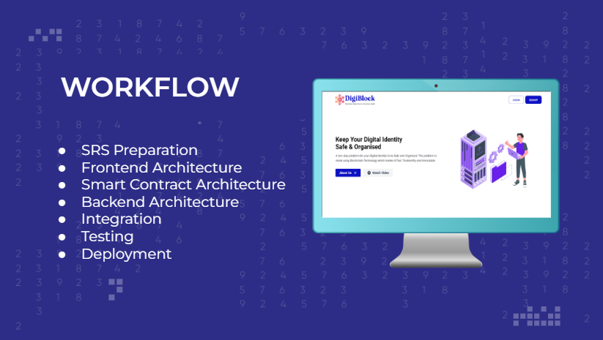
PROJECT DEMO
Let’s explore the product we have built!

Slide 16

CONCLUSION
We've devised a technique for securing the management of a user's data on the blockchain. It solves the problem of data loss while allowing users to share digital copies of the documents. It also attempts to provide users more visibility and granular control over their data. In addition, we examined the system for vulnerabilities using a variety of threat models.

Slide 17
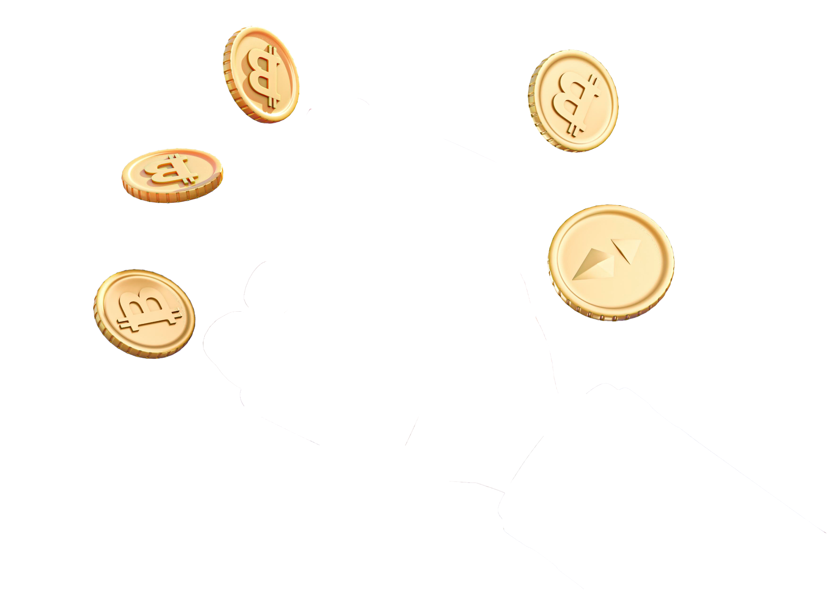

THANK YOU

